Slide 1
Cyber Security
محمد عبد الحميد طه أحمد (سكشن 7)
نهال عبد الحميد بدر أحمد (سكشن 7)

Slide 2

Definition
is the application of technologies, processes and controls to protect systems, networks, programs, devices and data from cyber-attacks.
It aims to reduce the risk of cyber-attacks and protect against the unauthorized exploitation of systems, networks and technologies.
With an increasing amount of people getting connected to Internet, the security threats that cause massive harm are increasing also.
Meaning of the Word “CYBER” It is a combining form relating to information technology, the Internet, and virtual reality.

Slide 3
Why do we need Cyber Security?
It is necessary since it helps in securing data from threats such as data theft or misuse, also safeguards your system from viruses.
Who needs cyber security?
Everyone who is connected to the Internet needs cyber security. This is because most cyber attacks are automated and aim to exploit common vulnerabilities rather than specific websites or organizations.

Slide 4
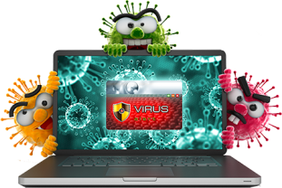
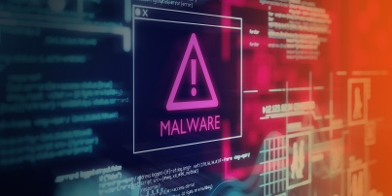
Major security problems:-
Viruses and Worms :
A Virus is a “program that is loaded onto your computer without your
knowledge and runs against your wishes.
Solution: Install a security suite that protects the computer against
threats such as viruses and worms.
Malware:
Malware is any software that infects and damages a computer
system without the owner's knowledge or permission .The word
"malware" comes from the term “malicious software“.
Solution: Download an anti-malware program that also helps
prevent infections. Activate Network Threat Protection, Firewall,
Antivirus.

Slide 5
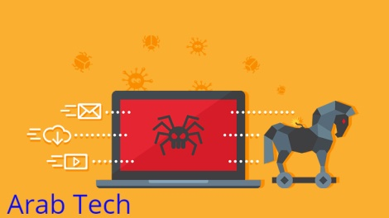
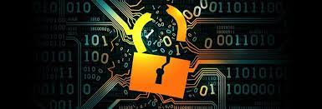
Trojan Horses:
They are email viruses that can duplicate themselves, steal
information, or harm the computer system. These viruses are the
most serious threats to computers.
Solution: Security suites, such as Avast Internet Security, will
prevent you from downloading Trojan Horses.
Password Cracking:
They are attacks by hackers that are able to determine passwords
or find passwords to different protected electronic areas and
social network sites.
Solution: Use always Strong password. Never use same password
for two different sites.

Slide 6
What are the 5 types of cyber security?
Critical infrastructure cyber security
Network security
Cloud security
IOT (Internet of Things) security
Application security

Slide 7
Cyber security vs information security
Cyber security
information security
focuses on protecting computer systems from unauthorized access or being otherwise damaged or made inaccessible.
It is a broader category that protects all information assets, whether in hard copy or digital form.

Slide 8

Hackers
hacker is a person who breaks into computers, usually by gaining access to administrative controls.
Types of Hackers:-
White Hat Hacker:
is a cybersecurity experts who use their skills to find
vulnerabilities in organizational networks and computer
systems. They are authorized to hack these systems for
the purpose of spotting security vulnerabilities before a
criminal hacker can. They help businesses prevent cybersecurity
attacks

Slide 9
2) Black Hat Hacker:
is a cybercriminal who breaks into computer systems with
malicious or criminal intent . Profit from data breaches.
These individuals can do serious harm to individuals and
organizations alike by stealing sensitive or personal data,
compromising entire computer systems, or altering critical
networks.
3) Grey Hat Hacker:
is a cybersecurity expert who finds ways to hack into computer
networks and systems, but without the malicious intent of a
black hat hacker. they engage in hacking activities for the pure
enjoyment of finding gaps in computer systems, and they
might even let the owner know if any weak points are found.

